Slide 1

Satellite Internet Communication Using OSI Layers
CSA0702 - Computer Networks
Presented By
M.Madhulika(192472188)
CSE-AI

Slide 2
Introduction to Satellite Internet
What is Satellite Internet?
Internet service provided through communication satellites.
Connects users in remote and rural areas.
Uses satellites instead of fiber or cable.
Enables global connectivity.
Components
User Terminal (Satellite Dish)
Satellite
Ground Station (Gateway)
Internet Service Provider (ISP)

Slide 3
Introduction to the OSI Model
OSI (Open Systems Interconnection) Model
Standard model for network communication.
Consists of 7 layers.
Each layer performs a specific function.
Ensures communication between different devices.

Slide 4
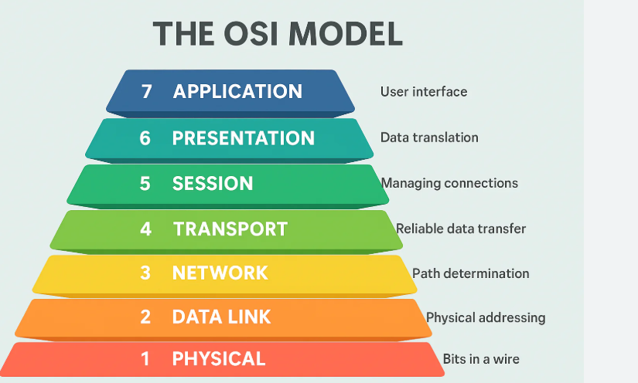
OSI Layers

Slide 5
Data Flow in Satellite Communication
Communication Process
User sends data.
Data passes through the OSI layers.
Satellite dish transmits signals.
Satellite relays data to the ground station.
Ground station connects to the Internet.
Response follows the same path back.

Slide 6
Advantages and Challenges
Advantages
Global coverage
Suitable for remote locations
Quick deployment
Supports emergency communication

Slide 7
Future Scope
Faster internet with LEO satellites.
Lower latency for better performance.
Improved global internet coverage.
Support for 6G networks.
Better connectivity for remote areas.
Growth of IoT and smart devices.

Slide 8
Conclusion
Satellite Internet provides connectivity where traditional networks are unavailable.
The OSI Model organizes communication into seven layers.
Each layer contributes to secure and reliable data transmission.
Together, Satellite Internet and the OSI Model enable efficient global communication.

Slide 9
Thank You

